Slide 1
Anet A8 Bricked Bootloader
Fix using Arduino

Slide 2
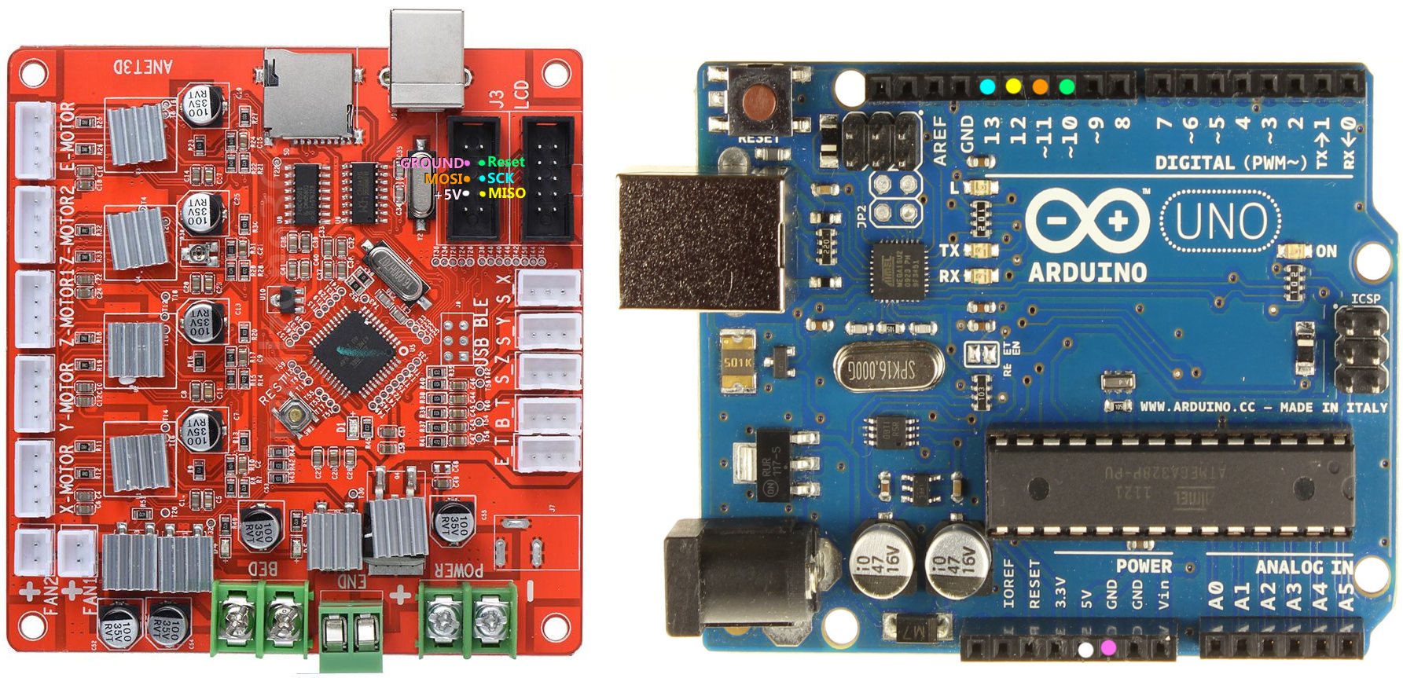
Wiring

Slide 3
PREPARE ARDUINO UNO AS ISP PROGRAMMER
1. Upload ArduinoISP sketch to Arduino Uno board (File -> Esempi)
2. Select from Arduino Tools menù:
a. Board:Arduino Uno
b. Port: COM X where your Arduino is connected
c. Programmer: AVRISP mkll
3. Upload Sketch
Arduino now is ready to act as ISP Programmer

Slide 4
FLASH BOOTLOADER
1. Select from Arduino Tools menù:
a. Board:Anet V1.0 (Optiboot)
b. Port: COM X where your Arduino is connected
c. Programmer: Arduino as ISP
2. Tools -> Write Bootloader

Slide 5
UPLOAD FIRMWARE
1. Select from Arduino Tools menù:
a. Board:Anet V1.0 (Optiboot)
b. Port: COM X where your Arduino is connected
c. Programmer: AVRISP mkll
2. Open Marlin firmware as usual
3. Upload sketch

